Slide 1
Application of M – Colouring Problem
Map Colouring
We are supposed to colour the states / union territories of a country,
India such that the states / Uts sharing the borders do not have same
colour.
India comprises of 28 states and 9 union territories.
We need to colour all 37 entities according to the condition specified above.
The maximum colours we can use are 4.
We will use BFS method to colour the map.

Slide 2
State code (GST) | Name of the state/Uts | Neighbouring States/Uts
1 | Jammu and Kashmir | 2,3,37
2 | Himachal Pradesh | 1,3,5,6,9,37
3 | Punjab | 1,2,4,6,8
4 | Chandigarh | 3,6
5 | Uttarakhand | 2,6,9
6 | Haryana | 2,3,4,5,7,8,9
7 | Delhi | 6,9
8 | Rajasthan | 3,6,9,23,24
9 | Uttar Pradesh | 2,5,6,7,8,10,20,22,23
10 | Bihar | 9,19,20
11 | Sikkim | 19
12 | Arunachal Pradesh | 13,18
13 | Nagaland | 12,14,18
14 | Manipur | 13,15,18
15 | Mizoram | 14,16,18
16 | Tripura | 15,18
17 | Meghalaya | 18
18 | Assam | 12,13,14,15,16,17,19
19 | West Bengal | 10,11,18,20,21
20 | Jharkhand | 9,10,19,21,22,23

Slide 3
21 | Odisha | 19,20,22,28
22 | Chattisgarh | 9,20,21,23,27,28,36
23 | Madhya Pradesh | 8,9,22,24,27
24 | Gujarat | 8,23,25,26,27
25 | Daman and Diu | 24
26 | Dadra and Nagar Haveli | 24,27
27 | Maharashtra | 22,23,24,26,29,30,36
28 | Andhra Pradesh | 21,22,29,33,34,36
29 | Karnataka | 27,28,30,32,33,36
30 | Goa | 27,29
31 | Lakshadweep Islands
32 | Kerala | 29,33,34
33 | Tamil Nadu | 28,29,32,34
34 | Pondicherry | 28,32,33
35 | Andaman and Nicobar Islands
36 | Telangana | 22,27,28,29
37 | Ladakh | 1,2

Slide 4
We will start iterating through all the nodes i.e. from i = 1 to n
If it is not visited then we will make it visited and push it in queue.
Then we will iterate till queue is not empty :
We will pop the element from the queue.
Then iterate through the adjacency list of that element.
If the vertex is not visited then, we will add them in the queue .
and check if their colour are same then we will increase the colour of latter vertex.
When the queue becomes empty we will move to next node.
We will initialize all entities to colour 1.

Slide 5
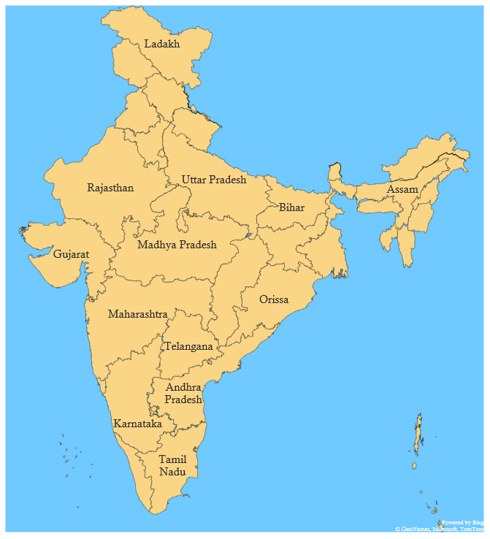
Visited : [0,0,0,0,0,0,0,0,0,0,0,0,0,0,0,0,0,0,0,0,0,0,0,0,0,0,0,
0,0,0,0,0,0,0,0,0,0]
Queue : [Empty]
i = 1
1
37
2
3
5
6
11
12
8
9
18
13
10
17
1 : Jammu and Kashmir
-> 2, 3, 37
Since, 1 is not visited
Therefore we will push 1 in queue.
And make it visited.
14
24
20
16
15
19
23
22
21
27
36
30
29
28
34
35
31
32
33
1
2
3
4

Slide 6
Visited : [1,0,0,0,0,0,0,0,0,0,0,0,0,0,0,0,0,0,0,0,0,0,0,0,0,0,0,
0,0,0,0,0,0,0,0,0,0]
Queue : [1]
i = 1
1
37
2
3
5
6
11
12
8
9
18
13
10
17
1 : Jammu and Kashmir
-> 2, 3, 37
Pop 1 from queue.
We will check each adjacent states and if they are not
Visited then make them visited and push it in queue.
14
24
20
16
15
19
23
22
21
27
36
30
29
28
34
35
31
32
33
1
2
3
4

Slide 7
Visited : [1,0,0,0,0,0,0,0,0,0,0,0,0,0,0,0,0,0,0,0,0,0,0,0,0,0,0,
0,0,0,0,0,0,0,0,0,0]
Queue : [Empty]
i = 1
1
37
2
3
5
6
11
12
8
9
18
13
10
17
1 : Jammu and Kashmir
-> 2, 3, 37
Since, Color of 1 and 2 are same .
Therefore color of 2 is increased by 1.
And also it is not visited, therefore we will push it in
queue
14
24
20
16
15
19
23
22
21
27
36
30
29
28
34
35
31
32
33
1
2
3
4

Slide 8
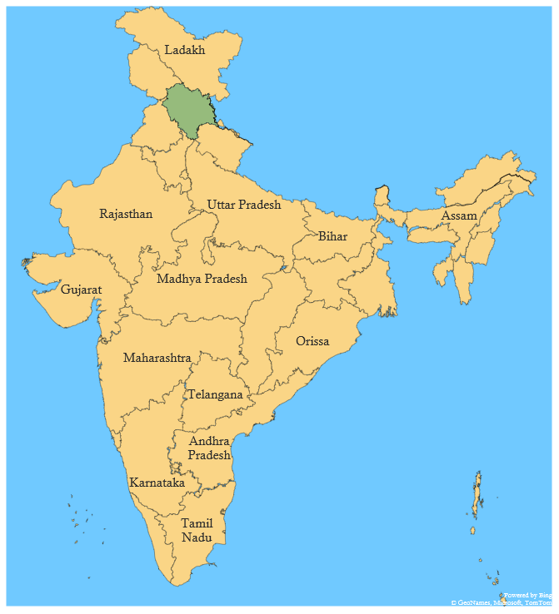
Visited : [1,1,0,0,0,0,0,0,0,0,0,0,0,0,0,0,0,0,0,0,0,0,0,0,0,0,0,
0,0,0,0,0,0,0,0,0,0]
Queue : [2,]
i = 1
1
37
2
3
5
6
11
12
8
9
18
13
10
17
1 : Jammu and Kashmir
-> 2, 3, 37
Since, Color of 1 and 3 are same .
Therefore color of 3 is increased by 1.
And also it is not visited, therefore we will push it in
queue
14
24
20
16
15
19
23
22
21
27
36
30
29
28
34
35
31
32
33
1
2
3
4

Slide 9
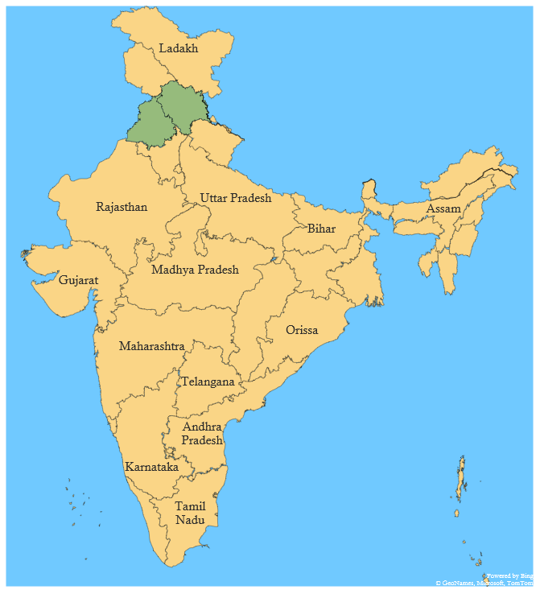
Visited : [1,1,1,0,0,0,0,0,0,0,0,0,0,0,0,0,0,0,0,0,0,0,0,0,0,0,
0,0,0,0,0,0,0,0,0,0]
Queue : [2,3]
i = 1
1
37
2
3
5
6
11
12
8
9
18
13
10
17
1 : Jammu and Kashmir
-> 2, 3, 37
Since, Color of 1 and 37 are same .
Therefore color of 37 is increased by 1.
And also it is not visited, therefore we will push it in
queue
14
24
20
16
15
19
23
22
21
27
36
30
29
28
34
35
31
32
33
1
2
3
4

Slide 10
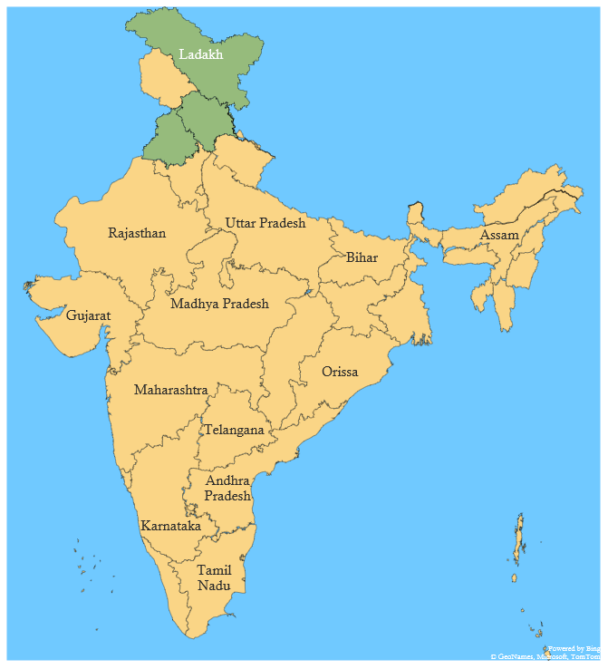
Visited : [1,1,1,0,0,0,0,0,0,0,0,0,0,0,0,0,0,0,0,0,0,0,0,0,0,0,
0,0,0,0,0,0,0,0,0,1]
Queue : [2,3,37]
i = 1
1
37
2
3
5
6
11
12
8
9
18
13
10
17
2 : Himachal Pradesh
2 -> 1, 3,5,6,37
Pop 2 from queue.
We will check each adjacent states and if they are not
Visited then make them visited and push it in queue.
14
24
20
16
15
19
23
22
21
27
36
30
29
28
34
35
31
32
33
1
2
3
4

Slide 11
Visited : [1,1,1,0,0,0,0,0,1,0,0,0,0,0,0,0,0,0,0,0,0,0,0,0,0,0,
0,0,0,0,0,0,0,0,0,1]
Queue : [3,37]
i = 1
1
37
2
3
5
6
11
12
8
9
18
13
10
17
2 : Himachal Pradesh
2 -> 1, 3,5,6,9,37
Since, Color of 1 and 2 are different and 1 is already
visited.
Therefore we will move further.
14
24
20
16
15
19
23
22
21
27
36
30
29
28
34
35
31
32
33
1
2
3
4

Slide 12
Visited : [1,1,1,0,0,0,0,0,0,0,0,0,0,0,0,0,0,0,0,0,0,0,0,0,0,0,
0,0,0,0,0,0,0,0,0,1]
Queue : [3,37]
i = 1
1
37
2
3
5
6
11
12
8
9
18
13
10
17
2 : Himachal Pradesh
-> 1, 3,5,6,9,37
Since, Color of 2 and 3 are same .
Therefore color of 3 is increased by 1.
And it is visited, therefore we will not push it in
Queue.
14
24
20
16
15
19
23
22
21
27
36
30
29
28
34
35
31
32
33
1
2
3
4

Slide 13
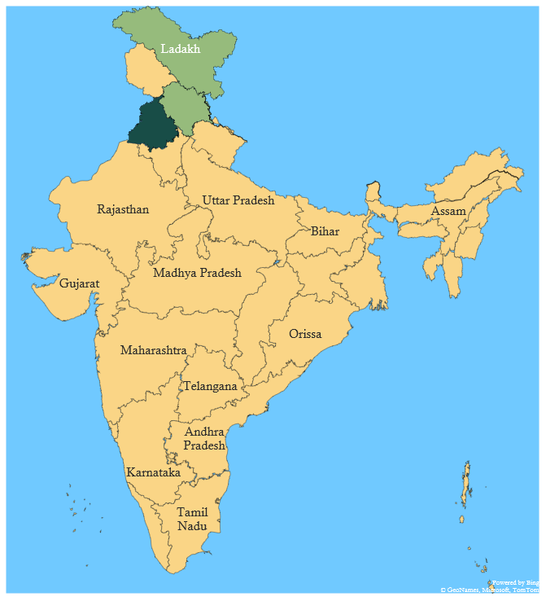
Visited : [1,1,1,0,0,0,0,0,0,0,0,0,0,0,0,0,0,0,0,0,0,0,0,0,0,0,
0,0,0,0,0,0,0,0,0,1]
Queue : [3,37]
i = 1
1
37
2
3
5
6
11
12
8
9
18
13
10
17
2 : Himachal Pradesh
-> 1, 3,5,6,9,37
Since, Color of 2 and 5 are different and 5 is not
Visited, therefore we will make it visited and push it in
Queue.
14
24
20
16
15
19
23
22
21
27
36
30
29
28
34
35
31
32
33
1
2
3
4

Slide 14
Visited : [1,1,1,0,1,0,0,0,0,0,0,0,0,0,0,0,0,0,0,0,0,0,0,0,0,0,
0,0,0,0,0,0,0,0,0,1]
Queue : [3,37,5]
i = 1
1
37
2
3
5
6
11
12
8
9
18
13
10
17
2 : Himachal Pradesh
-> 1, 3,5,6,9,37
Since, Color of 2 and 6 are different and 6 is not
Visited, therefore we will make it visited and push it in
Queue.
14
24
20
16
15
19
23
22
21
27
36
30
29
28
34
35
31
32
33
1
2
3
4

Slide 15
Visited : [1,1,1,0,1,0,0,0,1,0,0,0,0,0,0,0,0,0,0,0,0,0,0,0,0,0,
0,0,0,0,0,0,0,0,0,1]
Queue : [3,37,5,6]
i = 1
1
37
2
3
5
6
11
12
8
9
18
13
10
17
2 : Himachal Pradesh
-> 1, 3,5,6,9,37
Since, Color of 2 and 9 are different and 9 is not
Visited, therefore we will make it visited and push it in
Queue.
14
24
20
16
15
19
23
22
21
27
36
30
29
28
34
35
31
32
33
1
2
3
4

Slide 16
Visited : [1,1,1,0,1,1,0,0,1,0,0,0,0,0,0,0,0,0,0,0,0,0,0,0,0,0,
0,0,0,0,0,0,0,0,0,1]
Queue : [3,37,5,6,9]
i = 1
1
37
2
3
5
6
11
12
8
9
18
13
10
17
2 : Himachal Pradesh
-> 1, 3,5,6,9,37
Since, Color of 2 and 37 are same.
Therefore color of 37 is increased by 1.
And it is visited, therefore we will not push it in
Queue.
14
24
20
16
15
19
23
22
21
27
36
30
29
28
34
35
31
32
33
1
2
3
4

Slide 17
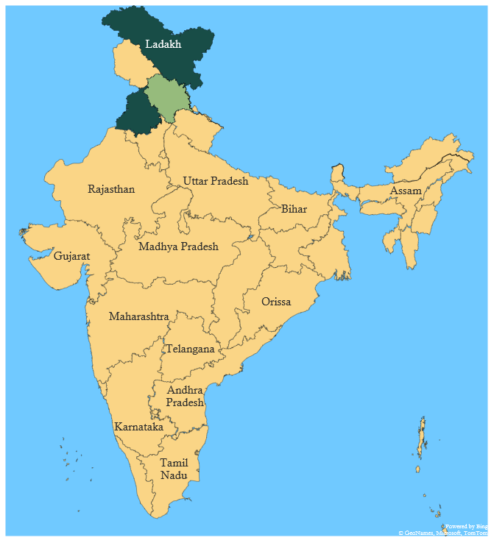
Visited : [1,1,1,0,1,1,0,0,1,0,0,0,0,0,0,0,0,0,0,0,0,0,0,0,0,0,
0,0,0,0,0,0,0,0,0,1]
Queue : [3,37,5,6,9]
i = 1
1
37
2
3
5
6
11
12
8
9
18
13
10
17
3 : Punjab
3 -> 1, 2,4,6,8
Pop 2 from queue.
We will check each adjacent states and if they are not
Visited then make them visited and push it in queue.
14
24
20
16
15
19
23
22
21
27
36
30
29
28
34
35
31
32
33
1
2
3
4

Slide 18
Visited : [1,1,1,0,1,1,0,0,1,0,0,0,0,0,0,0,0,0,0,0,0,0,0,0,0,0,
0,0,0,0,0,0,0,0,0,1]
Queue : [37,5,6,9]
i = 1
1
37
2
3
5
6
11
12
8
9
18
13
10
17
3 : Punjab
3 -> 1, 2,4,6,8
Since, Color of 1 and 3 are different and 1 is already
visited.
Therefore we will move further.
14
24
20
16
15
19
23
22
21
27
36
30
29
28
34
35
31
32
33
1
2
3
4

Slide 19
Visited : [1,1,1,0,1,1,0,0,1,0,0,0,0,0,0,0,0,0,0,0,0,0,0,0,0,0,
0,0,0,0,0,0,0,0,0,1]
Queue : [37,5,6,9]
i = 1
1
37
2
3
5
6
11
12
8
9
18
13
10
17
3 : Punjab
3 -> 1, 2,4,6,8
Since, Color of 2 and 3 are different and 2 is already
visited.
Therefore we will move further.
14
24
20
16
15
19
23
22
21
27
36
30
29
28
34
35
31
32
33
1
2
3
4

Slide 20
Visited : [1,1,1,0,1,1,0,0,1,0,0,0,0,0,0,0,0,0,0,0,0,0,0,0,0,0,
0,0,0,0,0,0,0,0,0,1]
Queue : [37,5,6,9]
i = 1
1
37
4
2
3
5
6
11
12
8
9
18
13
10
17
3 : Punjab
3 -> 1, 2,4,6,8
Since, Color of 4 and 3 are different and 4 is not visited.
Therefore we make it visited and push it in queue.
14
24
20
16
15
19
23
22
21
27
36
30
29
28
34
35
31
32
33
1
2
3
4

Slide 21
Visited : [1,1,1,1,1,1,0,0,1,0,0,0,0,0,0,0,0,0,0,0,0,0,0,0,0,0,
0,0,0,0,0,0,0,0,0,1]
Queue : [37,5,6,9,4]
i = 1
1
37
2
3
5
6
11
12
8
9
18
13
10
17
3 : Punjab
3 -> 1, 2,4,6,8
Since, Color of 6 and 3 are different and 6 is already
visited.
Therefore we will move further.
14
24
20
16
15
19
23
22
21
27
36
30
29
28
34
35
31
32
33
1
2
3
4

Slide 22
Visited : [1,1,1,1,1,1,0,0,1,0,0,0,0,0,0,0,0,0,0,0,0,0,0,0,0,0,
0,0,0,0,0,0,0,0,0,1]
Queue : [37,5,6,9,4]
i = 1
1
37
2
3
5
6
11
12
8
9
18
13
10
17
3 : Punjab
3 -> 1, 2,4,6,8
Since, Color of 8 and 3 are different and 8 is not visited.
Therefore we make it visited and push it in queue.
14
24
20
16
15
19
23
22
21
27
36
30
29
28
34
35
31
32
33
1
2
3
4

Slide 23
Visited : [1,1,1,1,1,1,0,1,1,0,0,0,0,0,0,0,0,0,0,0,0,0,0,0,0,0,
0,0,0,0,0,0,0,0,0,1]
Queue : [37,5,6,9,4,8]
i = 1
1
37
2
3
5
6
11
12
8
9
18
13
10
17
37 : Ladakh
37 -> 1, 2
We will Pop 37 from the queue.
So, we will follow the same steps as we did before.
And the Scenario after each pop would be as shown
Directly.
14
24
20
16
15
19
23
22
21
27
36
30
29
28
34
35
31
32
33
1
2
3
4

Slide 24
Visited : [1,1,1,1,1,1,0,1,1,0,0,0,0,0,0,0,0,0,0,0,0,0,0,0,0,0,
0,0,0,0,0,0,0,0,0,1]
Queue : [5,6,9,4,8]
i = 1
1
37
2
3
5
6
11
12
8
9
18
13
After Popping 37 (Ladakh) and performing all steps :
Now pop 5 from the queue.
10
17
14
24
20
16
15
19
23
22
21
27
36
30
29
28
34
35
31
32
33
1
2
3
4

Slide 25
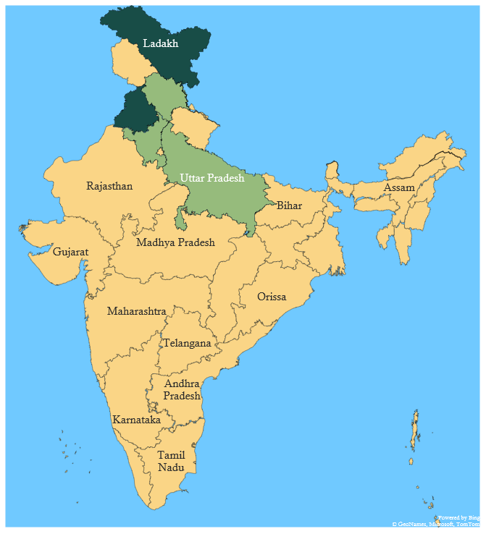
Visited : [1,1,1,1,1,1,0,1,1,0,0,0,0,0,0,0,0,0,0,0,0,0,0,0,0,0,
0,0,0,0,0,0,0,0,0,1]
Queue : [6,9,4,8]
i = 1
1
37
2
3
5
6
11
12
8
9
18
13
5 -> 2,6,9
After Popping 5 (Uttarakhand) and performing all steps :
Now pop 6 from the queue.
10
17
14
24
20
16
15
19
23
22
21
27
36
30
29
28
34
35
31
32
33
1
2
3
4

Slide 26
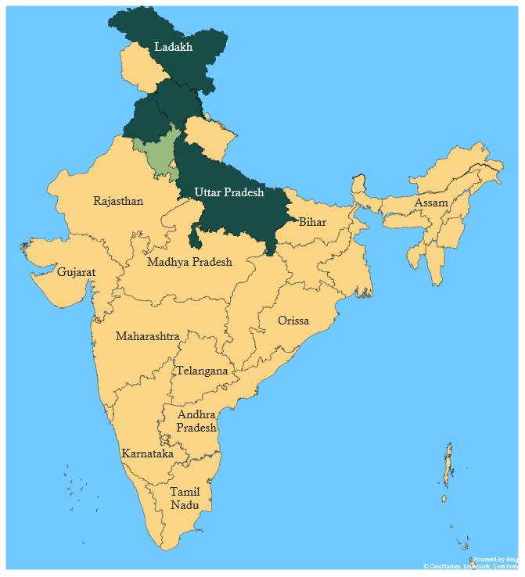
Visited : [1,1,1,1,1,1,1,1,1,0,0,0,0,0,0,0,0,0,0,0,0,0,0,0,0,0,
0,0,0,0,0,0,0,0,0,1]
Queue : [9,4,8,7]
i = 1
1
37
2
3
5
6
11
12
8
9
18
13
6 -> 2,3,4,5,7,8,9
After Popping 6 (Haryana) and performing all steps :
Now pop 9 from the queue.
10
17
14
24
20
16
15
19
23
22
21
27
36
30
29
28
34
35
31
32
33
1
2
3
4

Slide 27
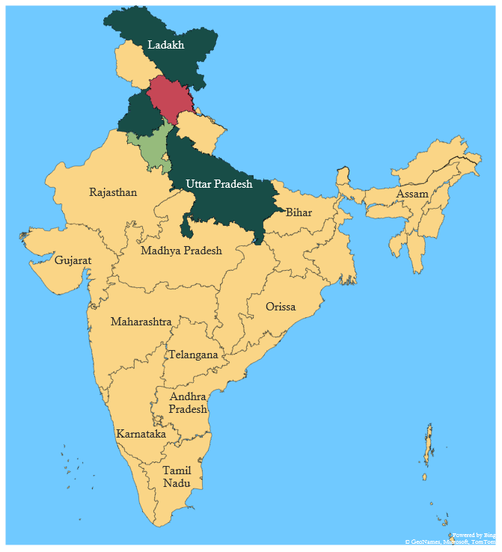
Visited : [1,1,1,1,1,1,1,1,1,1,0,0,0,0,0,0,0,0,0,1,0,1,1,0,0,0,
0,0,0,0,0,0,0,0,0,1]
Queue : [4,8,7,10,20,22,23]
i = 1
1
37
2
3
5
6
11
12
8
9
18
13
9 -> 2,5,6,7,8,10,20,22,23
After Popping 9 (UttarPradesh) and performing
all steps :
Now pop 4 from the queue.
10
17
14
24
20
16
15
19
23
22
21
27
36
30
29
28
34
35
31
32
33
1
2
3
4

Slide 28
Visited : [1,1,1,1,1,1,1,1,1,1,0,0,0,0,0,0,0,0,0,1,0,1,1,0,0,0,
0,0,0,0,0,0,0,0,0,1]
Queue : [8,7,10,20,22,23]
i = 1
1
37
2
3
5
6
11
12
8
9
18
13
4 -> 3,6
After Popping 4 (Chandigarh) and performing
all steps :
Now pop 8 from the queue.
10
17
14
24
20
16
15
19
23
22
21
27
36
30
29
28
34
35
31
32
33
1
2
3
4

Slide 29
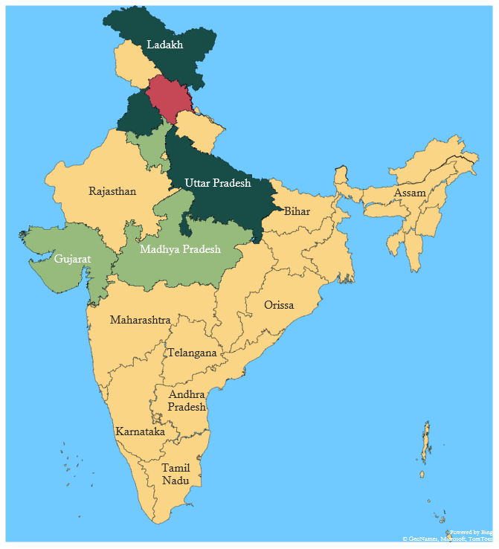
Visited : [1,1,1,1,1,1,1,1,1,1,0,0,0,0,0,0,0,0,0,1,0,1,1,1,0,0,
0,0,0,0,0,0,0,0,0,1]
Queue : [7,10,20,22,23,24]
i = 1
1
37
2
3
5
6
11
12
8
9
18
13
8 -> 3,6,9,23,24
After Popping 8 (Rajasthan) and performing
all steps :
Now pop 7 from the queue.
10
17
14
24
20
16
15
19
23
22
21
27
36
30
29
28
34
35
31
32
33
1
2
3
4

Slide 30
Visited : [1,1,1,1,1,1,1,1,1,1,0,0,0,0,0,0,0,0,0,1,0,1,1,1,0,0,
0,0,0,0,0,0,0,0,0,1]
Queue : [10,20,22,23,24]
i = 1
1
37
2
3
5
6
11
12
8
9
18
13
7 -> 6,9
After Popping 7 (Delhi) and performing
all steps :
Now pop 10 from the queue.
10
17
14
24
20
16
15
19
23
22
21
27
36
30
29
28
34
35
31
32
33
1
2
3
4

Slide 31
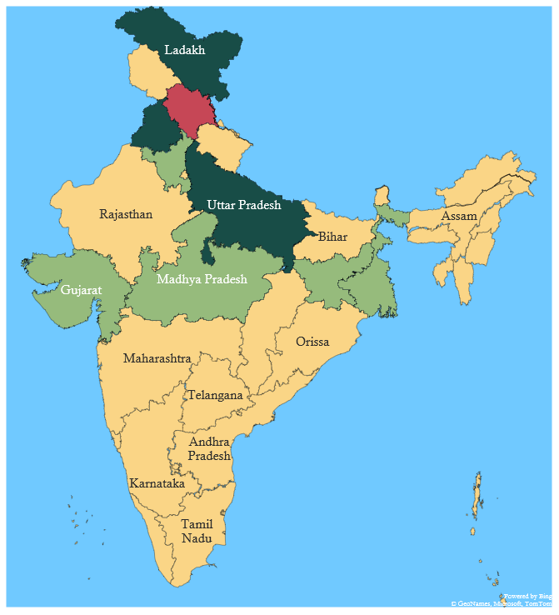
Visited : [1,1,1,1,1,1,1,1,1,1,0,0,0,0,0,0,0,0,1,1,0,1,1,1,0,0,
0,0,0,0,0,0,0,0,0,1]
Queue : [20,22,23,24,19]
i = 1
1
37
2
3
5
6
11
12
8
9
18
13
10 -> 9,19,20
After Popping 10 (Bihar) and performing
all steps :
Now pop 20 from the queue.
10
17
14
24
20
16
15
19
23
22
21
27
36
30
29
28
34
35
31
32
33
1
2
3
4

Slide 32
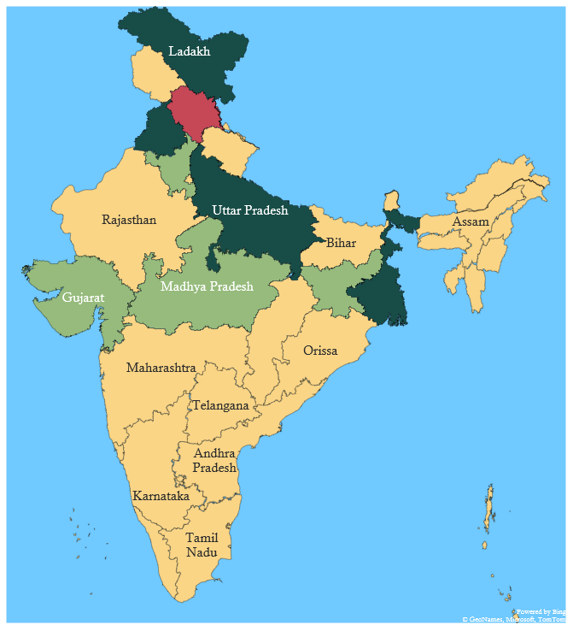
Visited : [1,1,1,1,1,1,1,1,1,1,0,0,0,0,0,0,0,0,1,1,1,1,1,1,0,0,
0,0,0,0,0,0,0,0,0,1]
Queue : [22,23,24,19,21]
i = 1
1
37
2
3
5
6
11
12
8
9
18
13
20 -> 9,10,19,21,22
After Popping 20 (Jharkhand) and performing
all steps :
Now pop 22 from the queue.
10
17
14
24
20
16
15
19
23
22
21
27
36
30
29
28
34
35
31
32
33
1
2
3
4

Slide 33
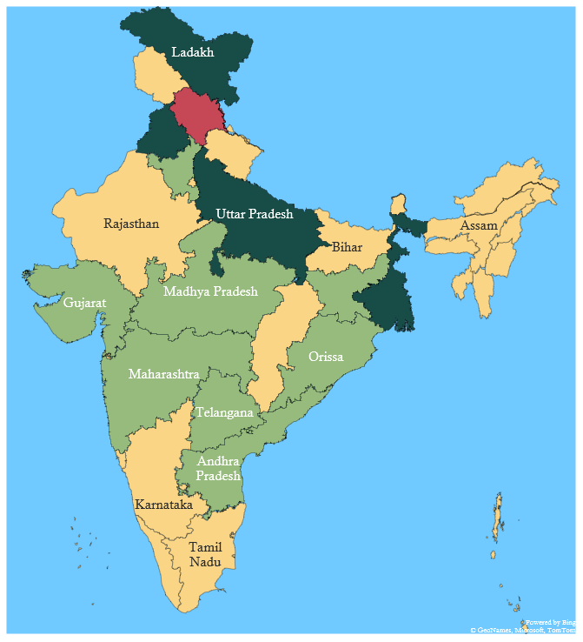
Visited : [1,1,1,1,1,1,1,1,1,1,0,0,0,0,0,0,0,0,1,1,1,1,1,1,0,0,
1,1,0,0,0,0,0,0,1,1]
Queue : [23,24,19,21,27,28,36]
i = 1
1
37
2
3
5
6
11
12
8
9
18
13
22 -> 9,20,21,23,27,28,36
After Popping 22 (Chattisgarh) and performing
all steps :
Now pop 23 from the queue.
10
17
14
24
20
16
15
19
23
22
21
27
36
30
29
28
34
35
31
32
33
1
2
3
4

Slide 34
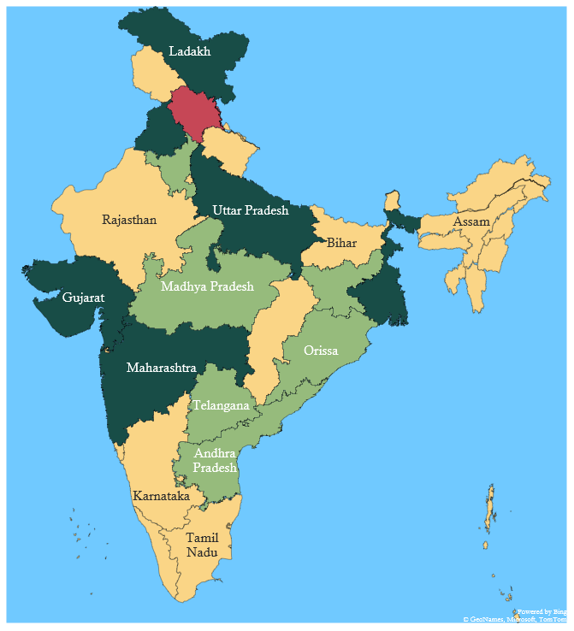
Visited : [1,1,1,1,1,1,1,1,1,1,0,0,0,0,0,0,0,0,1,1,1,1,1,1,0,0,
1,1,0,0,0,0,0,0,1,1]
Queue : [24,19,21,27,28,36]
i = 1
1
37
2
3
5
6
11
12
8
9
18
13
23 -> 8,9,22,24,27
After Popping 23 (Madhya Pradesh) and performing
all steps :
Now pop 24 from the queue.
10
17
14
24
20
16
15
19
23
22
21
27
36
30
29
28
34
35
31
32
33
1
2
3
4

Slide 35
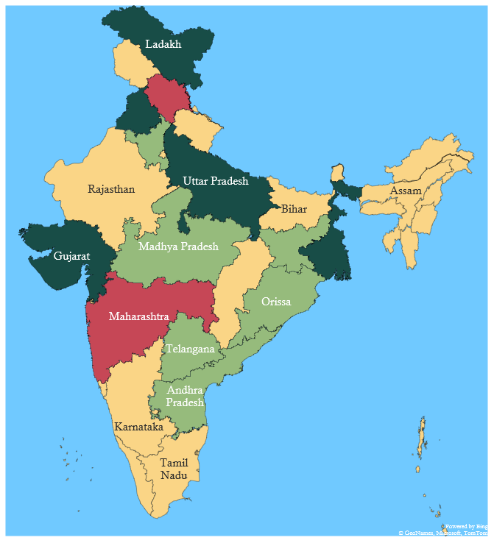
Visited : [1,1,1,1,1,1,1,1,1,1,0,0,0,0,0,0,0,0,1,1,1,1,1,1,1,1,
1,1,0,0,0,0,0,0,1,1]
Queue : [19,21,27,28,36,25,26]
i = 1
1
37
2
3
5
6
11
12
8
9
18
13
24 -> 8,23,25,26,27
After Popping 24 (Gujarat) and performing
all steps :
Now pop 19 from the queue.
10
17
14
24
20
16
15
19
23
22
21
27
36
30
29
28
34
35
31
32
33
1
2
3
4

Slide 36
Visited : [1,1,1,1,1,1,1,1,1,1,1,0,0,0,0,0,0,1,1,1,1,1,1,1,1,1,
1,1,0,0,0,0,0,0,1,1]
Queue : [21,27,28,36,25,26,11,18]
i = 1
1
37
2
3
5
6
11
12
8
9
18
13
19 -> 10,11,18,20,21
After Popping 19 (West Bengal) and performing
all steps :
10
17
14
24
20
16
15
19
23
22
21
27
36
30
29
28
34
35
31
32
33
1
2
3
4

Slide 37
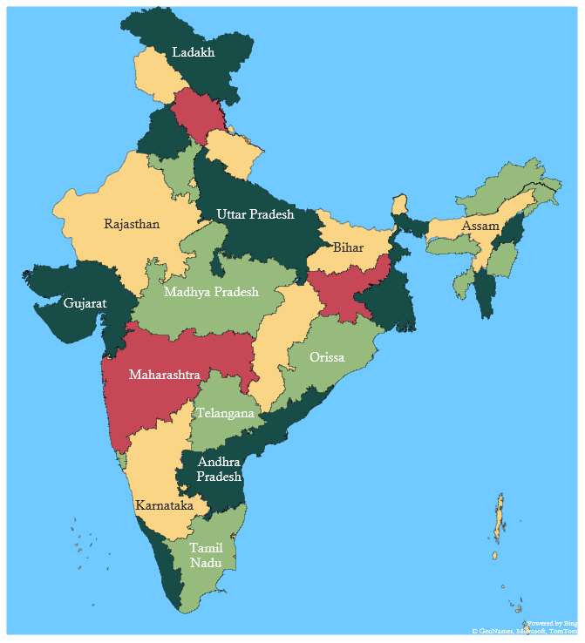
Visited : [1,1,1,1,1,1,1,1,1,1,1,1,1,1,1,1,1,1,1,1,1,1,1,1,1,1,
1,1,1,0,1,1,1,0,1,1]
Queue : [Empty]
i = 1
1
37
2
3
5
6
11
12
8
9
18
13
So, we will iterate similarly till the queue is not empty.
And the Colouring would be as :
10
17
14
24
20
16
15
19
23
22
21
27
36
30
29
28
34
35
31
32
33
1
2
3
4

Slide 38
Visited : [1,1,1,1,1,1,1,1,1,1,1,1,1,1,1,1,1,1,1,1,1,1,1,1,1,1,
1,1,1,0,1,1,1,0,1,1]
Queue : [Empty]
1
37
2
3
5
6
11
12
8
9
18
13
Now we will iterate through i = 2 to 37, but for
i = 2 to 30 , 32 to 34, 36, 37 , they are already visited
Therefore we will not perform steps for this nodes
Unlike we did for i = 1.
Since, 31 and 35 are not visited .
Therefore we will push them into queue.
10
17
14
24
20
16
15
19
23
22
21
27
36
30
29
28
34
35
31
32
33
1
2
3
4

Slide 39
Visited : [1,1,1,1,1,1,1,1,1,1,1,1,1,1,1,1,1,1,1,1,1,1,1,1,1,1,
1,1,1,1,1,1,1,0,1,1]
Queue : [31]
i = 31
1
37
2
3
5
6
11
12
8
9
18
13
-> NULL
We made 31 as visited and pushed it in queue.
Now, we will pop it in queue and iterate through all
Adjacent vertices.
But it does not have any vertices.
So, we will move further from i = 32 to 34.
Then push 35 in queue.
10
17
14
24
20
16
15
19
23
22
21
27
36
30
29
28
34
35
31
32
33
1
2
3
4

Slide 40
Visited : [1,1,1,1,1,1,1,1,1,1,1,1,1,1,1,1,1,1,1,1,1,1,1,1,1,1,
1,1,1,1,1,1,1,1,1,1]
Queue : [35]
i = 35
1
37
2
3
5
6
11
12
8
9
18
13
-> NULL
We made 35 as visited and pushed it in queue.
Now, we will pop it in queue and iterate through all
Adjacent vertices.
But it does not have any vertices.
So, we will move further from i = 36 to 37.
10
17
14
24
20
16
15
19
23
22
21
27
36
30
29
28
34
35
31
32
33

Slide 41
Maximum Colours Used : 4
1
37
2
State code (GST) | Name of the state/Uts | Colour No.
1 | Jammu and Kashmir | 1
2 | Himachal Pradesh | 4
3 | Punjab | 3
4 | Chandigarh | 1
5 | Uttarakhand | 1
6 | Haryana | 2
7 | Delhi | 1
8 | Rajasthan | 1
9 | Uttar Pradesh | 3
10 | Bihar | 1
11 | Sikkim | 1
12 | Arunachal Pradesh | 2
13 | Nagaland | 3
14 | Manipur | 2
15 | Mizoram | 3
16 | Tripura | 2
17 | Meghalaya | 2
18 | Assam | 1
19 | West Bengal | 3
20 | Jharkhand | 4
3
5
6
11
12
8
9
18
13
10
17
14
24
20
16
15
19
23
22
21
27
36
30
29
28
34
35
31
32
33
1
2
3
4

Slide 42
Maximum Colours Used : 4
1
37
2
3
5
21 | Odisha | 2
22 | Chattisgarh | 1
23 | Madhya Pradesh | 2
24 | Gujarat | 3
25 | Daman and Diu | 1
26 | Dadra and Nagar Haveli | 1
27 | Maharashtra | 4
28 | Andhra Pradesh | 3
29 | Karnataka | 1
30 | Goa | 2
31 | Lakshadweep Islands | 1
32 | Kerala | 3
33 | Tamil Nadu | 2
34 | Pondicherry | 1
35 | Andaman and Nicobar Islands | 1
36 | Telangana | 2
37 | Ladakh | 3
6
11
12
8
9
18
13
10
17
14
24
20
16
15
19
23
22
21
27
36
30
29
28
34
35
31
32
33
1
2
3
4

Slide 43
Thank You !

